Slide 1



Disability Advantage
Facilitated by
Deb Dagit, Corporate Disability Inclusion Consultant, Disability:IN

Slide 2

Disability Advantage: Starbucks
Presenter
Sevana Massih, Inclusion & Diversity Specialist SR., Accessibility Office
Disability Advantage: Qualcomm
Presenters
Eric Morris, Senior Staff Manager Support Engineer
Pierre Polk, CISSP, MBA, Engineering Information Governance Lead

Slide 3
Roadmap to Mental Wellness in the Workplace

Slide 4
Thermo Fischer Scientific
Presenter
Rueben Stokes, Vice President, Global Diversity & Inclusion

Slide 5
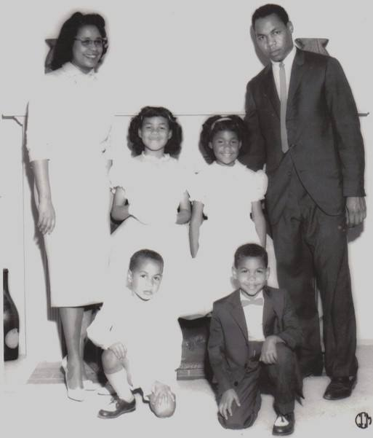
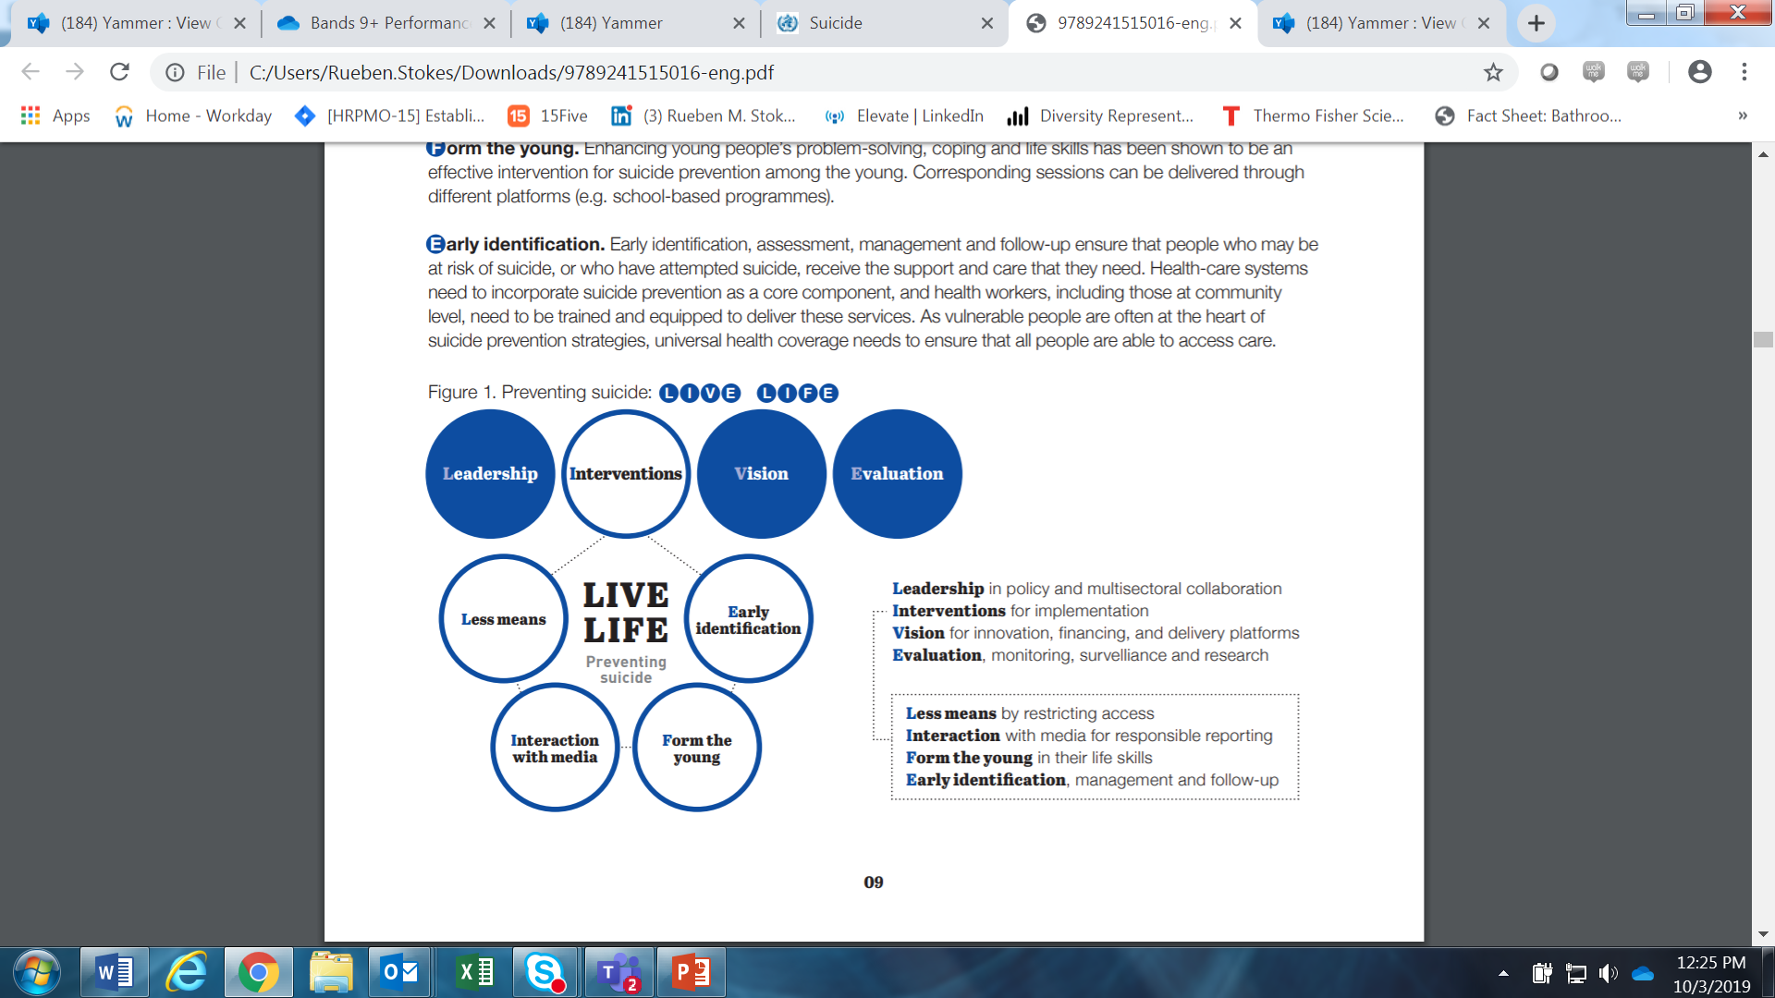
Suicide Prevention
“A permanent solution to a temporary problem”
800,000 People die due to suicide annually
One person every 40 seconds
For each suicide there are 20 others attempting suicide
Evidence based interventions prevent suicide and suicide attempts

Slide 6
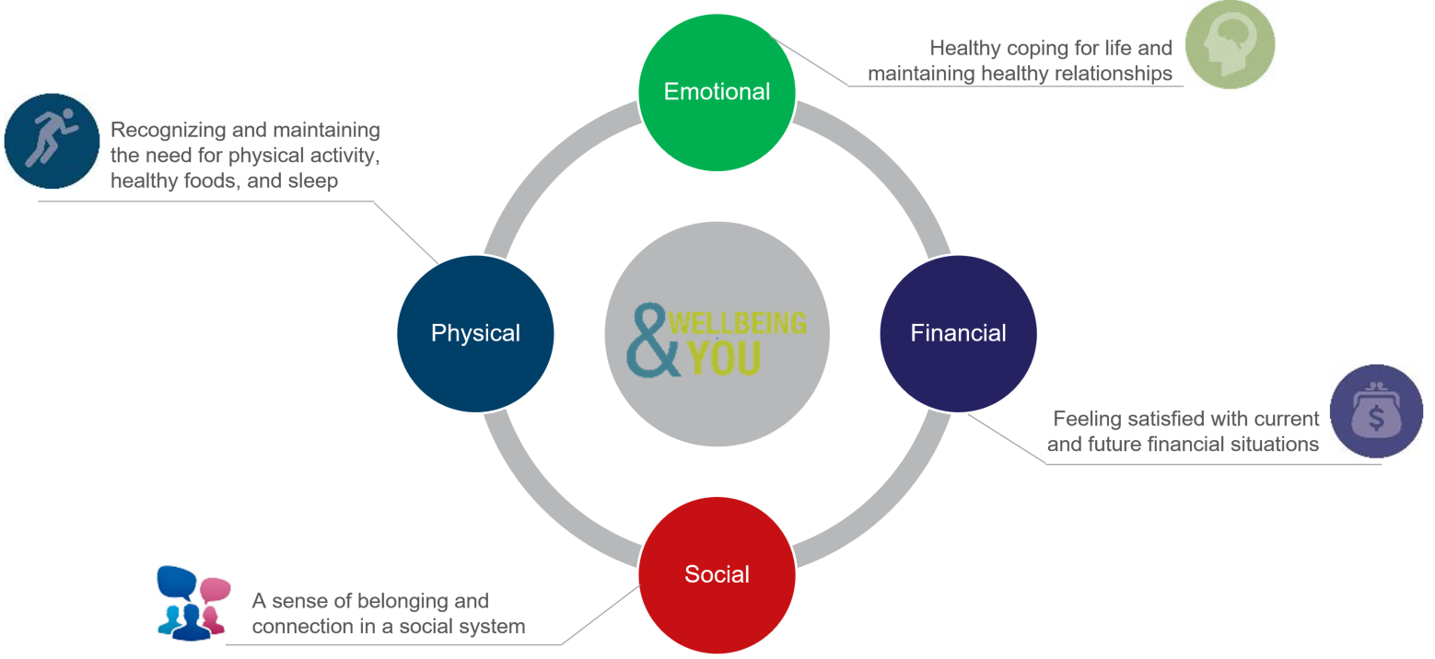
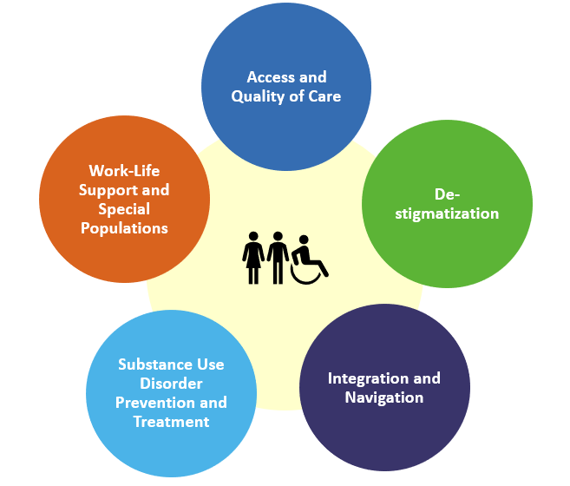
Behavioral Health Strategy Integral to Holistic Approach to Wellbeing
Wellbeing at Thermo Fisher Means
Supporting Our Colleagues’ Total Health
The 5 Pillars of Mental Health Strategy
Data Driven Analysis
Evidence-Based Solutions
Engagement
Measurement

Slide 7
Accenture
Presenter
Alison Cupito, Global Mental Health Program Lead

Slide 8

Mental Health Matters
Alison.R.Cupito@accenture.com
Global Mental Health Lead
Inclusion & Diversity Center of Expertise
Notes:
US Mental Wellness ERG
Lisa Homan, National Lead (Columbus, OH)
Arielle Zwang, National Co-Lead (New York, NY)
http://go.acenture.com/MentalHealthUS

Slide 9
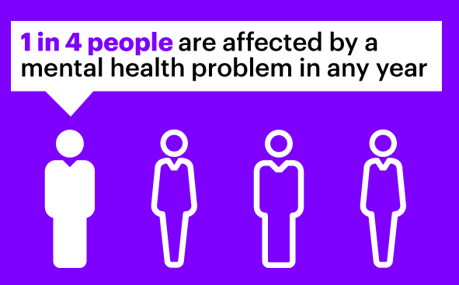
We are facing a global mental health crisis
350 MILLION
People have depression in the world. And 450 million have poor mental health. A recent survey showed 1 in 20 people reported having an episode of depression in the previous year. By 2030, depression will be the second highest cause of disability in middle-income countries, and the third highest in low-income countries (World Health Organization)
$6 TRILLION BY 2030
The global cost (medical care, loss of income due to unemployment, expenses for social supports, and a range of indirect costs due to a chronic disability) of mental illness is projected to increase to over $6 trillion by 2030. (NIMH, 2013)
US $2.5 TRILLION
Mental health problems constitute the largest single source of world economic burden, with an estimated global cost of $2.5 trillion – greater than cardiovascular disease, chronic respiratory disease, cancer, and diabetes on their own (Mentalhealth.org.uk)
25%
It is estimated that up to 25% of the costs of
mental health issues to employers can be
avoided (Not myself Today, Canada)
Notes:
Source:
Globally, 1 in 4 people have a mental disorder in both developed and developing countries. (Who) : http://www.who.int/whr/2001/media_centre/press_release/en/
US$2.5 trillion (Mentalhealth.org.uk): https://www.mentalhealth.org.uk/sites/default/files/fundamental-facts-15.pdf
Globally, more than 350 million people have depression and 450 million have poor mental health. The World Mental Health Survey conducted in 17 countries found that on average about 1 in 20 people reported having an episode of depression in the previous year. By 2030, depression will be the second highest cause of disability in middle-income countries and the third highest in low-income countries. :http://www.who.int/mediacentre/factsheets/fs369/en/
$6 trillion by 2030 is the global cost (medical care, loss of income due to unemployment, expenses for social supports, and a range of indirect costs due to a chronic disability) of mental illness is projected to increase to over $6 trillion by 2030. (NIMH, 2013) :https://www.nimh.nih.gov/about/director/2011/the-global-cost-of-mental-illness.shtml (September 28th 2011)
It is estimated that up to 25% of the costs of mental health issues to employers can be avoided: http://2016.notmyselftoday.ca/the-issue/the-solution/

Slide 10
Companies have the power to change mental health outcomes…
Young Workers | In Less Supportive Organizations | In More Supportive Organizations
Have a recent history of mental health challenges | 65% | 41%
Are able to cope with the everyday stresses of work | 51% | 91%
Are able to cope at work with any mental health challenges they have | 39% | 84%
Work impacts their mental health in a positive way | 15% | 57%

Slide 11
In supportive organizations there’s a truly different kind of leader
Employees tell us… | In Less Supportive Organizations | In More Supportive Organizations
Senior leaders are visible in supporting those with mental health challenges | 2% | 53%
Leaders are ‘open, warm and human’ when it comes to employee mental health | 5% | 88%
There’s a senior person I could turn to for help with a mental health challenge | 17% | 87%
There’s a senior person who genuinely cares about my wellbeing | 23% | 82%
2%
5%
17%
23%
Copyright © 2019 Accenture. All rights reserved.
11
11

Slide 12
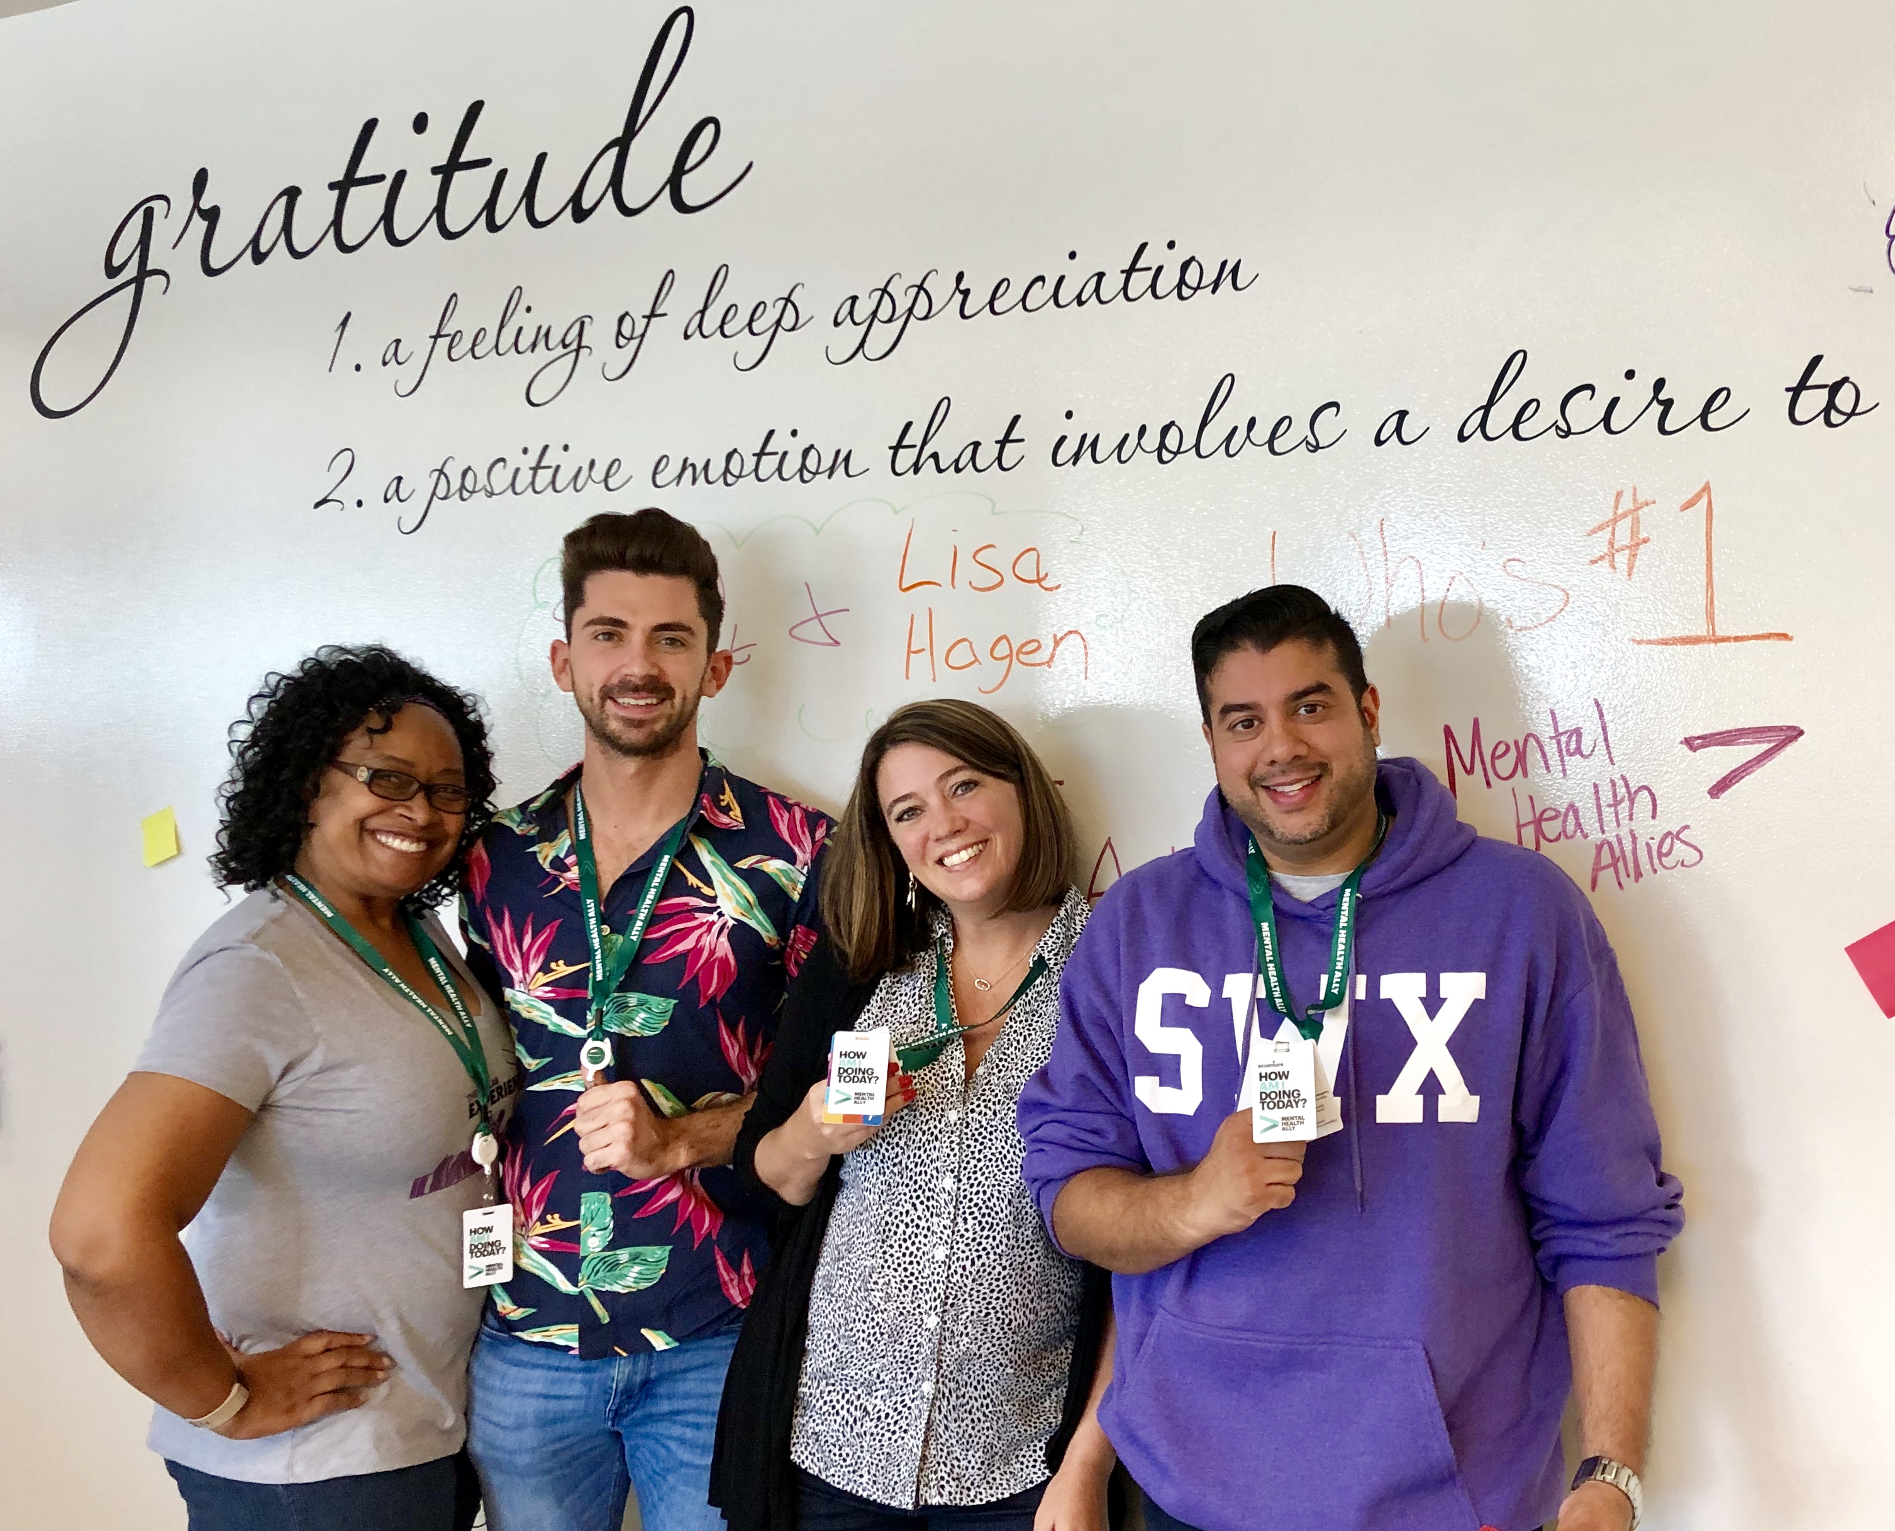
What is a mental health ally?
Volunteer representatives from across Accenture
Personally passionate about supporting mental health awareness and education
They act as a “go-to” resource for people seeking support or information for themselves or someone else on mental health
They are available to listen and provide open, honest, non-judgemental support
They are trained on mental health topics and Accenture resources available to you
They are NOT psychologists, psychiatrists or therapists
They will point you to our resources provided by HR, Employee Assistance Program (EAP), Wellness Champions, career counsellors and line managers

Slide 13
Facebook
Presenter
Clare Miller, Life@ Mental Health Program Manager

Slide 14
Leveraging Your Suppliers to Advance Inclusive Hiring

Slide 15
Microsoft RE&F Supported Employment Program
Presenters
Brian Collins, Senior Manager, Change Management, Real Estate & Facilities
Gillian Maguire, Program Manager, Supported Employment, CBRE
Austin Landon, Project Coordinator, Supported Employment, CBRE

Slide 16
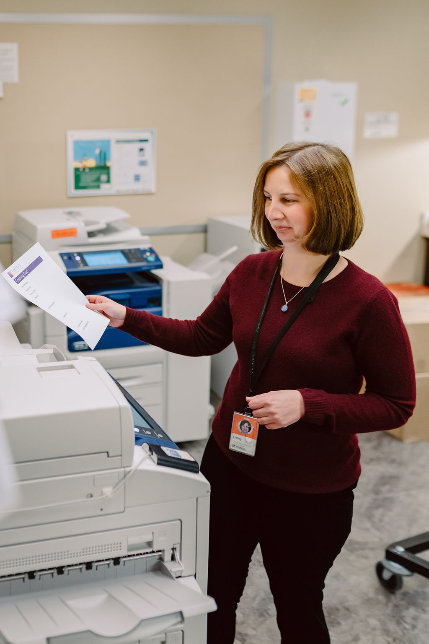
Today
Program Overview
Jobs
Starting a Supported Employment Program
More Information

Slide 17

Share Best Practices
Program Overview

Slide 18
About Microsoft
Microsoft’s mission is to empower every person and every organization on the planet to achieve more.
Microsoft is committed to enabling workforce diversity and inclusion at the company and beyond.
Microsoft partners with vendors and local Supported Employment agencies to make a substantial difference in the lives of people with intellectual and developmental disabilities who might otherwise be overlooked in the job market.
Notes:
Decreased turnover
Increased empathy
Increased community engagement
Increased diversity
Marketing opportunities
Untapped labor force
Return on investment
Morale boost

Slide 19
Quote
“
”
There is great value in hiring a diverse workforce; it’s the right thing to do and its good for business.
Notes:
Decreased turnover
Increased empathy
Increased community engagement
Increased diversity
Marketing opportunities
Untapped labor force
Return on investment
Morale boost

Slide 20
Involved Parties
Supported Employee
The employer identifies a job, pays the employee’s wages, and assigns a manager to oversee their work.
The job candidate and family choose a coaching agency to assist with interviews, job retention, and mastering job tasks.
Job Coach
Employer
The job coach is paid by the state or other government funded agency.
The employer is not responsible for paying any fees to the coaching agency.
Program Manager
Notes:
Gillian
Supported Employee
The supported employee is paid by the employer directly (vendor partner). If the supported employee is being hired from CBRE – NorAm, then funding must be approved through the normal new role process. If the position is already in place and we are conducting a back-fill not additional approval is necessary for funds/budget unless the salary has changed.
Job Coach
Job coaches are not paid by the employer (vendor partner). In fact, they are paid by a government funding agency, so you do not need to worry about their payment in your budget.
Program Manager
The program manager and SEP team roles are reimbursed by the client.

Slide 21
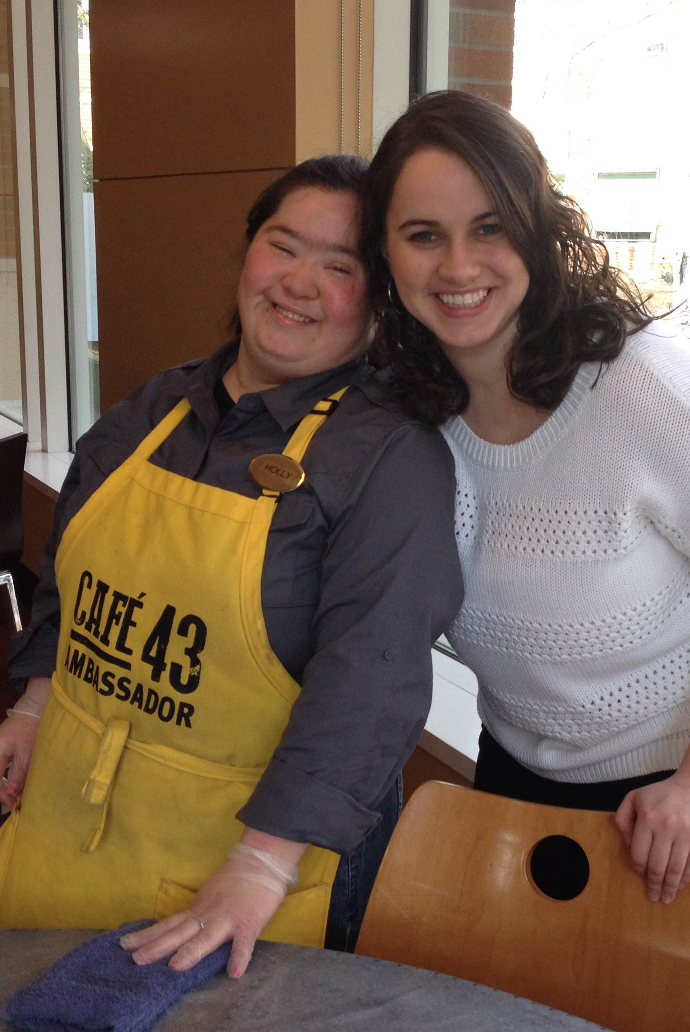

The Role of the Job Coach
Coach
Employee
Employer
  Job readiness & job retention
  Resource to the employer
  Ongoing relationship
Notes:
Lizzie –
Who pays for the services of the Coach?

Slide 22
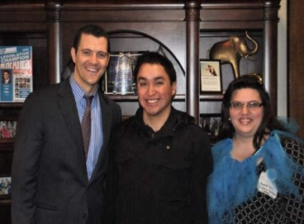
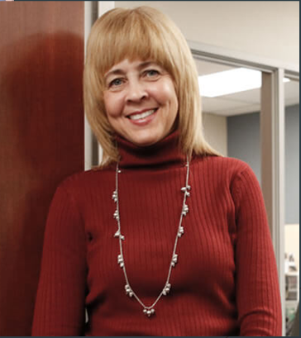
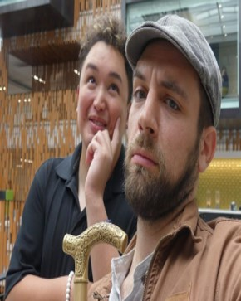
The importance of a Job Coach
Brenda Kim, Highline
Diane King, Mainstay
Max Doggett, Highline
Notes:
Austin

Slide 23
Jobs

Slide 24
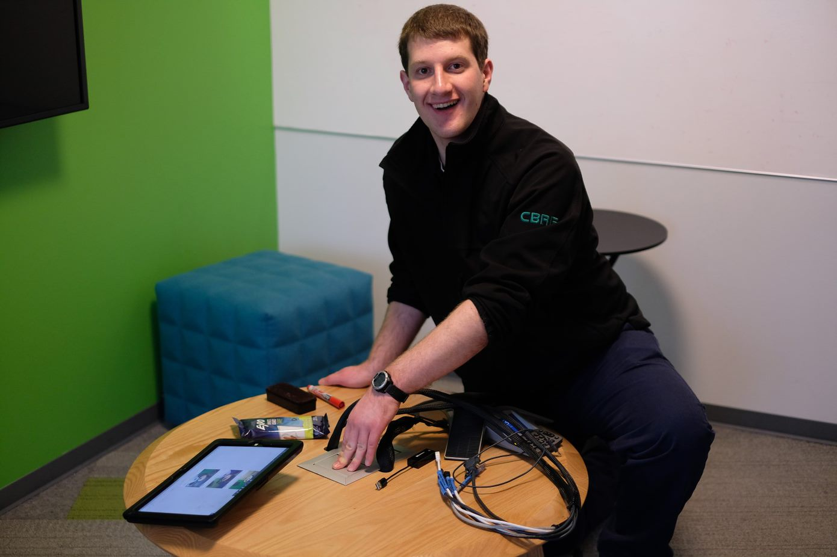
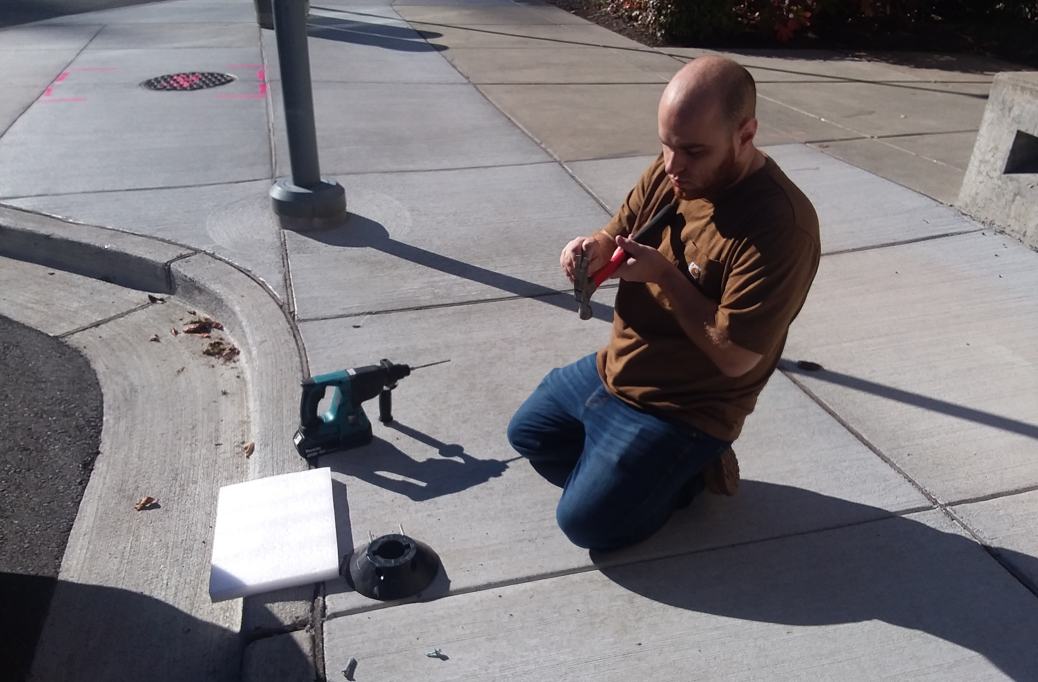
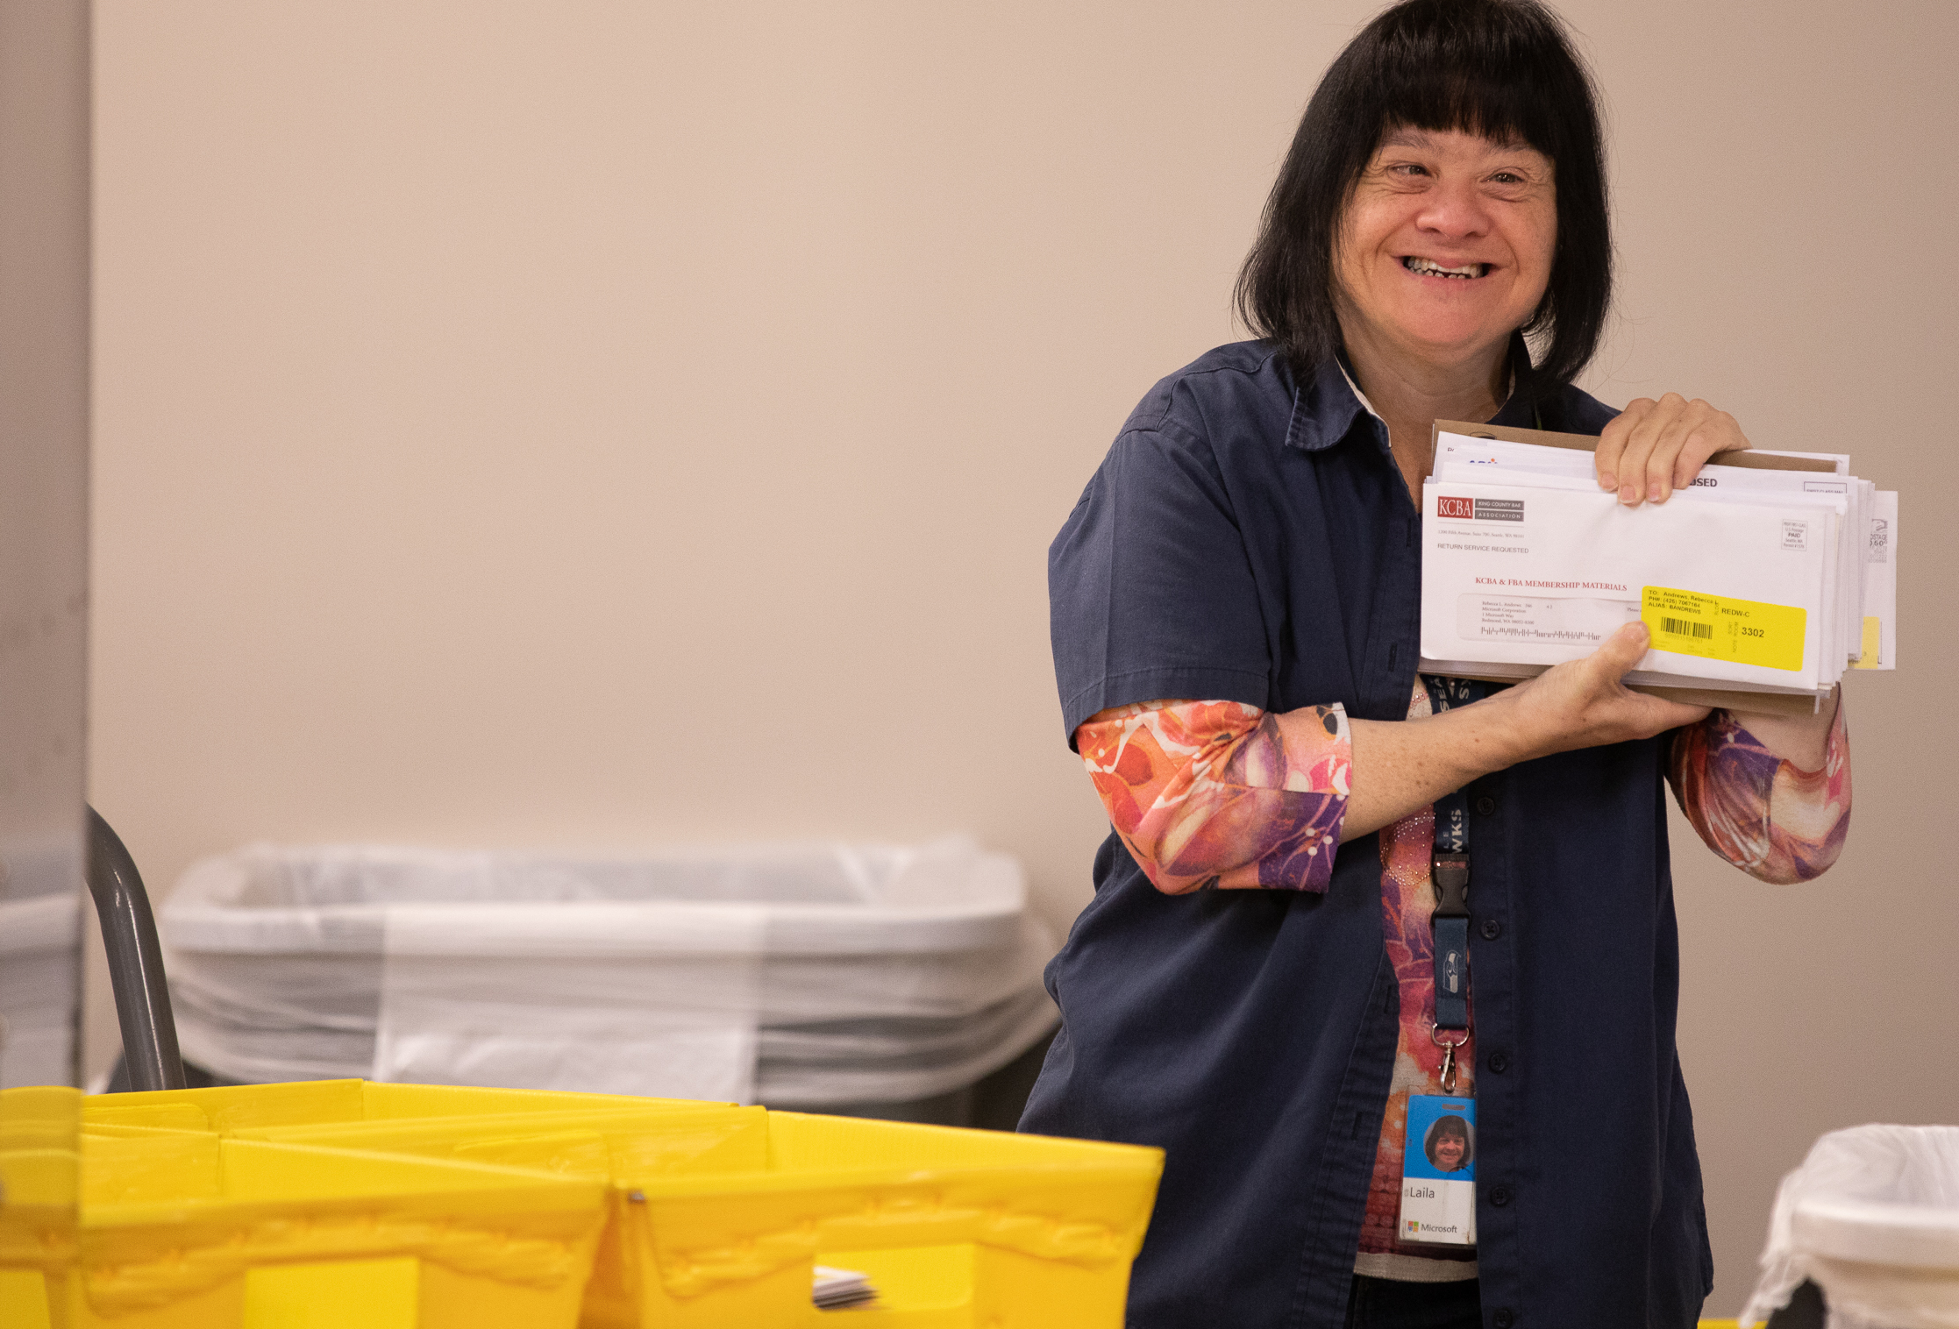
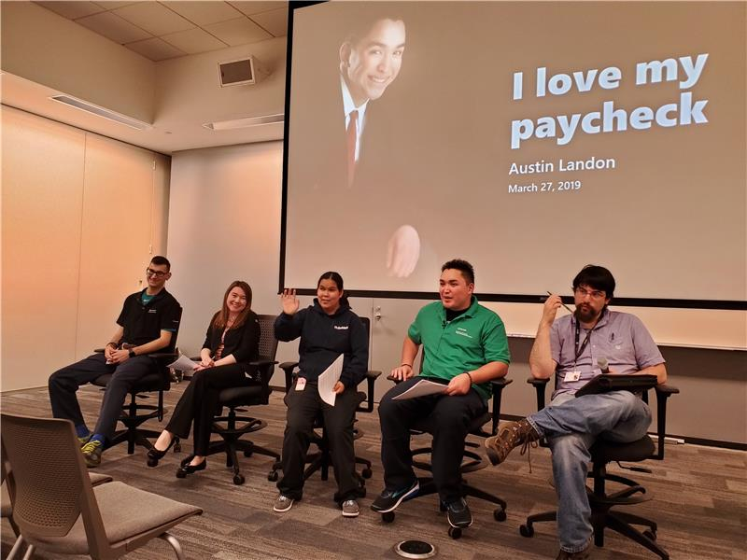
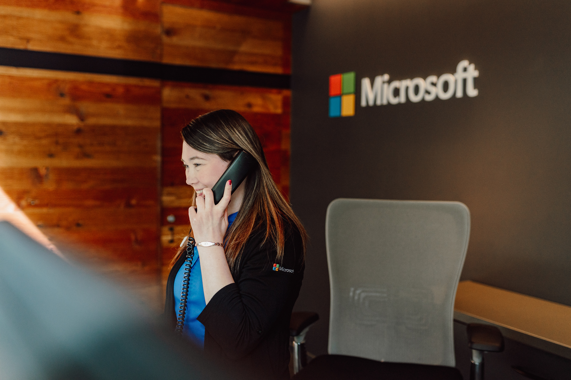

Jobs in Action
Common Area Reset
Maintenance Assistant
Mail Services
Project Coordinator
Lobby Host
Delivery Driver
Notes:
On the Puget Sound campus we have 24 CBRE Supported Employees in both full and part time roles. Most of these are customer facing and are providing key functions to allow activities on campus run smoothly.
Common Area Reset- Play Austin video. responsible for auditing all the common areas on campus to make sure the furniture is functioning as designed.
The CAR Team is really a jumping off point for other roles within the facilities management sector of CBRE. It allows a great space for employees to familiarize themselves with the client as well as the tech used within the team and really learn how to navigate campus.
Maintenance Assistant- this role as filled by a supported employee evolved from the CAR Team. Marc pictured here started with the CAR Team, quickly evolved into fulfilling name badge work orders, and now has been promoted to replacing signage all over campus and working with various tools and teams in order to get it done. Most recently, when we checked in with his team, the manager reported they would be meeting soon to give Marc an even bigger role on their team and assign new responsibilities. This story of career progression came out of a team wanting to hire an SE but had some trepidations about the learning curve of being on campus. So we worked together and found someone suited for next steps in their career journey and it has been smooth sailing ever since they brought Marc on board.
We have folks in Mail Services- featured here is Laila and she has been with Microsoft for over 25 years. She assists with delivery and distribution for all incoming mail to campus.
Within the SE Team, we have our third teammate, Austin Landon. He provides various supports to different teams within CBRE however, one of his primary roles is to share his story and help show the impact and success Supported Employment has on people with intellectual and developmental disabilities.
Lobby Host- this is Cassie. She is a lobby host, and she serves as the first impression for guests and employees at Microsoft. Our lobby hosts help with signing in visitors, requesting shuttles, and assisting with securing meeting spaces.
Delivery Driver- Tim drives all over campus and making deliveries.

Slide 25



Other Models
MOD Pizza
  Employer: MOD Pizza
  Employees: 300 nationwide
  Roles: Associates at each location
City of Seattle
  Employer: City of Seattle
  Employees: 200
  Roles: Various City Departments
Bank of America
Employer: Bank of America
Employees: 300 nationwide
Roles: Support Services Group

Slide 26
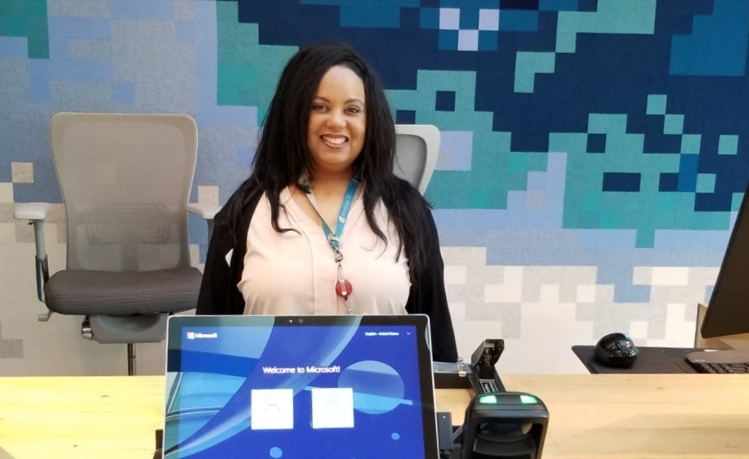
Potential Sources of Jobs
Entry-level positions
High turnover jobs
Open requisitions
Components of existing jobs
Notes:
We are available to consult as you take these first brainstormed ideas to the next step.
We have supported the expansion across the US and Globally.
We are supporting CBRE colleagues as they build new programs at other client locations.

Slide 27
Starting your own Supported Employment Program

Slide 28





Hiring your first Supported Employee
Socialize program with leadership and team and identify a program sponsor
Chose from 1-2 job coaching agencies, (send RFI), and select desired partner
Identify vendor to hire first Supported Employee. Assist vendor in defining roles, hours and tasks
The job coach identifies candidates and supports the candidate through the interview process
Vendor is responsible for interview, hiring and job offer process with the Supported Employee
Vendor onboards Supported Employee with Job Coach as needed
The job coach provides customized job support to the employee, which can remain or phase out overtime
Share the program with other vendors to increase number of Supported Employees
Notes:
Gillian

Slide 29
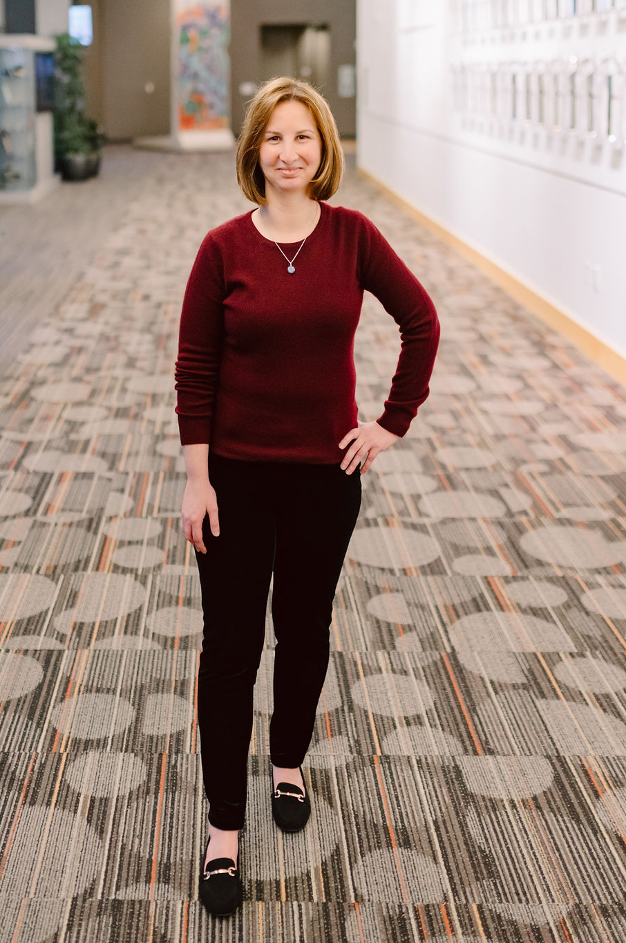
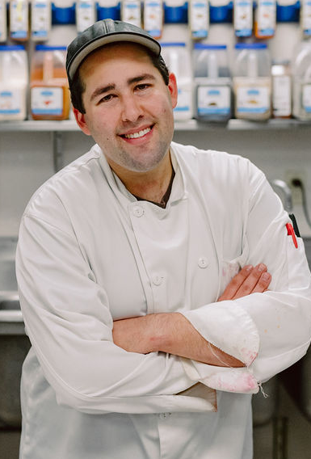
Sustaining
Seek champions @ leadership
Commit to inclusion
Celebrate the stories
Keep hiring

Slide 30
More Information

Slide 31

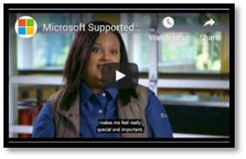


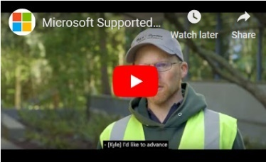
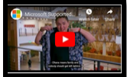
Learn More
aka.ms/supportedemployment
supportedemployment@microsoft.com

Slide 32
Amazon Alternative Workforce Supplier Program
Presenters
Lee Whitley, Senior Program Manager, Launch and Learning
Ilia Movchan, Senior Program Manager, Vendor Management

Slide 33
Overview
The Amazon Alternative Workforce Supplier Program (AWSP) is a new staffing program tailored to meet the needs of individuals who have traditionally faced obstacles to both entering and advancing in the workplace, beginning with People with Disabilities.
Focus is on fulfillment center roles
11 suppliers across 12 states (US) and 2 suppliers in 2 provinces (Canada)
1,341 hires since 2015 across 50 Amazon locations
Aligns and enhances Amazon core values
Metrics show multiple layers of success including better than average attendance & attrition
Learn more about AWSP at : www.amazon.com/allabilites
Notes:
Speaker Notes:
Hyperlink will take audience to the AWSP external facing: www.amazon.com/allabilities
-We will then guide them to watch success story of Erica on the website
2) Focus on fulfillment roles, expanding to other role types in 2020
3) Aligns and enhances Amazon core values of being an inclusive employer
4) Hires growing progressively: over the last 5 years; e.g. 8 in 2015, 35 in 2016, 252 in 2017, 373 in 2018, and 678 in 2019, grand total 1,341
5) Projected to hire over 1,000 through the program in 2020

Slide 34


How it Works
Culture and Process
Partner with experts in the community
Alignment and commitment from internal stakeholders
Training and integration into operations
Resources and education
Notes:
Speaker Notes:
Describe suppliers simulation process (supplier are informing candidates of job to see if it’s a fit prior to application).
Describing coaching support (badged to come onsite, provide coaching up to 90 days)
3) Describe sites commitment to place LO’s consistently on a monthly basis , schedule that we share with our suppliers
4) Partnerships with local recruiting teams
5) Describe training and SOP’s created for AWSP (KNET, Wiki site we have with resources)

Slide 35

What’s Next?
Challenges & Next Steps
Key Challenge: Scalability
Key Next Step: Growth into new businesses
Notes:
Speaker Notes:
Describe the challenge of work with states and nonprofits at scale. Getting buy in to do this in a structured way with external partners was initially a challenge but something we overcame. Must ensure there is great state and recruiting partnerships
Next Steps: Briefly mention of All Abilities across fulfillment network, www.amazon.com/allabilities

Slide 36
Q&A

Slide 37
Neurodiversity at Work
Facilitated by
Patrick Poljan, Chief Audit Executive
Dell Technologies

Slide 38
Dell
Presenters
Patrick Poljan, Chief Audit Executive and Global True Ability Executive Sponsor
Nick Turner, Advisor, Diversity & Inclusion

Slide 39




| Neurodiversity Hiring Program
Dell’s Program is in Year 3 with 20 full-time hires in Massachusetts and Texas, with 10-15 projected new hires in 2020
Local Hiring Process
No relocations
Local support system
Professional job coaching
Employee Resource Group (ERG) with dedicated Talent Acquisition Support
Strong community partnership with HMEA, The Arc, and Neurodiversity in the Workplace
2 week non- traditional assessment
12 week internship
Goal: Full-time hire
Wide variety of roles: Data Analytics, Cybersecurity, Accounting, Robotics, Engineering, etc.
Manager and Work Buddy Awareness Training
Intimate Onboarding Experience

Slide 40

| Neurodiversity Hiring Program cont.
Diverse Talent
Business Outcomes Combats Talent Shortage
Community and CSR Impact
Strong Brand Message Employee Morale
Successes
Success Factors | Areas to Watch
Passionate, driven, and engaged team members Focus on Business Imperatives and Outcomes Executive Sponsorship and Support Strong Community Partners Inclusive Company Culture set by Leadership team | Program Funding Competition with other Diversity & Inclusion efforts Growing Responsibly Managing communications and relationship with media Career Progression

Slide 41
Bank of America
Presenter
Mary Lynn MacKenzie, Senior Vice President, Diversity Talent Acquisition, Global Human Resources

Slide 42
Bank of America| Neurodiversity @ BofA
Program Overview
Conducted 1st cohort in October 2019
Two-week training and assessment program
Nine candidates participated
Seven hired into full time roles – Cybersecurity Analyst, Production Support Analyst
Six of the seven new hires relocated to Charlotte
Keys to Success
Partnering with Neurodiversity in the Workplace
Identifying an Executive Champion early
Training HR team and hiring managers in advance
Selecting a location where you have the right support infrastructure
Conducting a post-program assessment
Key Learnings
Start sourcing candidates well in advance and include employee referrals
Build in more time between recruitment and the start of the program; and between offers and start date
Plan for more time in the program for formal and informal engagement between hiring managers and candidates
Hold a meeting during the two week program for the hiring managers and job coaches to connect

Slide 43
Qualcomm
Presenters
Rashmi Char, Vice President of Engineering
Matt Harris, Senior Talent Acquisition Specialist

Slide 44
Qualcomm Program Guideline
Plan | Recruit/Pre-screen | Skills Evaluation | Hire & On-Board
Identify Hiring Teams/Roles | Work with NFAR to build Pipeline through Vocational program | 1 day in-person recruitment event hosted on campus | Autism training on Autism in the Workplace and 90-day onboarding support
Obtain a champion within the Organization to Pilot the program with Work with Manager to identify roles that make sense and tailor Job Description to needs | Resume/minimum requirement review with Hiring Team Pre-screening phone/email chat with Talent Acquisition Technical skills assessment exercise reviewed by interview team | Hosted by Talent Acquisition and hiring team to assess workability and professional readiness Team introductions, Interview preparation and Skills assessment | Accommodations team handling 1 off requests Establishing Technical Mentors and Community Mentors through Employee network Orientation Run by Talent Acquisition setting framework for success

Slide 45
Qualcomm Pilot Program Outcome
Sourced from 12 Graduates of local SW Testing training program (NFAR)
Brought 6 candidates on-site for a day long Interview (Tours, Face to Face, Hands-on)
All 6 Candidates hired as Interns (only 4 slots originally)
All 6 candidates received varying degrees of positive evaluations
All 6 Hired into 3 different roles at Qualcomm after Internship

Slide 46
Thermo Fischer Scientific
Presenter 2
Pammi Bhullar, Senior Manager, Global Diversity & Inclusion

Slide 47

Neurodiversity Hiring Pilot
1
2
3
  Interview
2-week interview in Carlsbad, CA
Workplace Norms
LinkedIn Profile, Resume, & Technical Portfolio
Hiring Manager Meet n’ Greet
Technical Skills Project
Presentation & Selection
  Candidate Support
Neurodiversity in the Workplace
Arc of San Diego – Job Coaches
Peer Mentors
Hiring Manager Training
  Size
4 Designated Full-Time Roles
All Data Science Roles
8 Candidates
4
5
6
  Implementation Partners
  PossAbilities ERG Executive Sponsor
  Neurodiversity in the Workplace
  Arc of San Diego
  Advocates & Hiring Managers
  Cost
  $50,000, includes:
  Fee for service to 2 nonprofit partners
  Catering for 2 weeks
  Travel & Expenses for D&I Program Leader
  Preparation
  Business Case Developed & Approved (3 months)
  Role Identification (3-4 months)
  Recruiting (3 months)

Slide 48
Neurodiversity Hiring Pilot cont.
Successes | Challenges
Hired 6 out of 8 Candidates Featured by CEO Demonstrated Business Impact Strengthens Employee Morale | Identifying a Dedicated Program Leader Identifying Roles in Advance Respecting Privacy while Building Awareness
Critical Success Factors
Exceptional Executive Leadership Support
Committed Neurodiversity Consultants & Coaches
Dedicated Program Leader
Engaged Hiring Managers
2nd Cohort
Consistent Interview Process
Expanding Program & Disciplines
2-weeks in Carlsbad, CA
Arc of San Diego
Neurodiversity in the Workplace
Identify 8 Designated Roles
Data Science, Software Developers, Computer Science, & Software Testing

Slide 49
Digital Accessibility Quick Bites: Procurement, Legal Issues, Resources
Facilitated by
Glen Williams, Director, Global Inclusion and Diversity, Qualcomm

Slide 50
Law Office of Lainey Feingold
Presenter
Lainey Feingold, Law Office of Lainey Feingold

