Slide 1
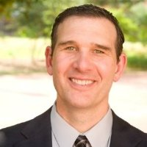
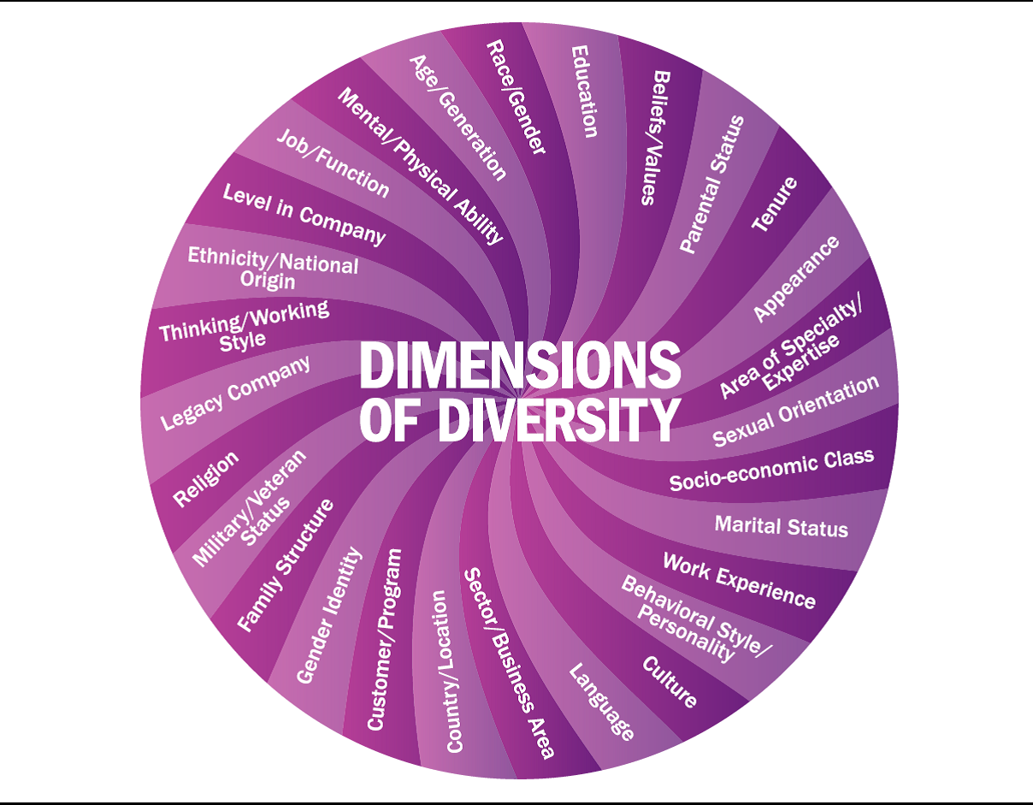
I am…
A husband & father of 3 AND
A former college basketball player AND
1 of 3 generations with blindness AND
A law school graduate AND
A U.S. Paralympic tandem cyclist AND
Not limited by myself or others AND
Encouraging others in the workplace to focus on abilities, not limitations.
I am Jason Bryn, Workforce Disabilities Program Manager
Sign up on MCN OneSpace page to join the Abilities Beyond Limits and Expectations (ABLE) Employee Resource Group to advance disability inclusion in our workplace and communities.
http://onespace.baesystems.com/mcn

